Slide 1
Safe Loading
יאיר לסרי & רועי גרוס
בהנחיית מר אריה הנל

Slide 2
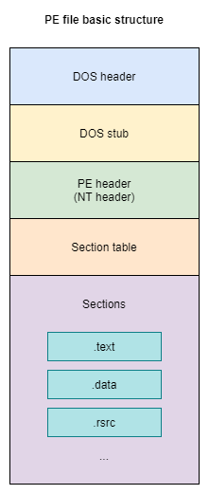
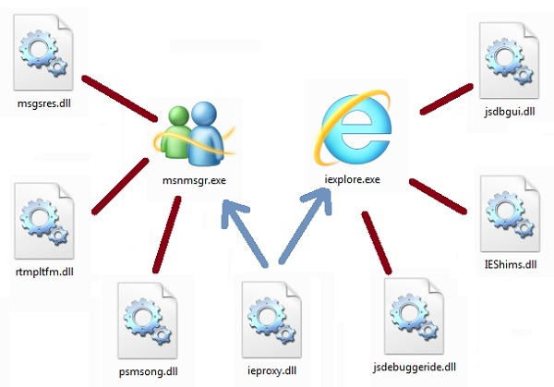
What is a DLL?
Shared Code
Dynamic Loading
Common Use
PE Format

Slide 3
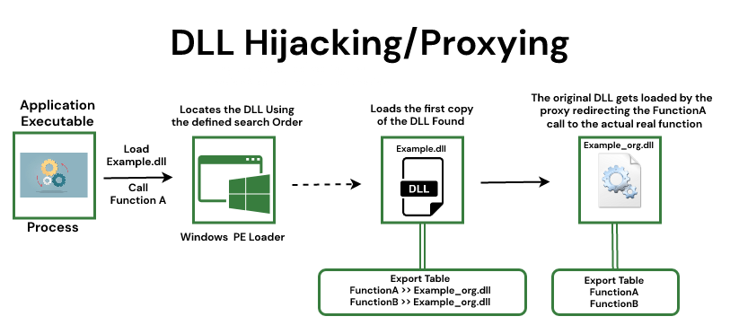
DLL Hijacking
Create Rogue DLL with the same name
Replace with original
Enjoy ☺

Slide 4
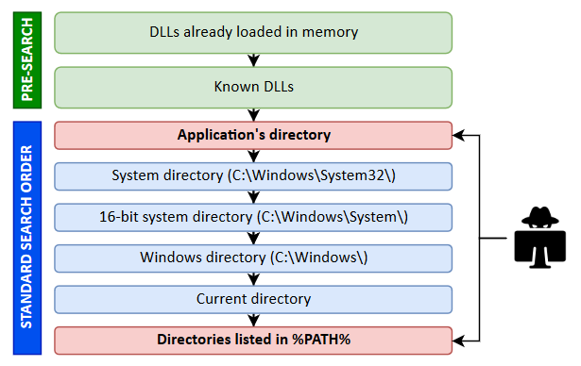
DLL Loading Search Order
Place rogue DLL earlier in the search order

Slide 5
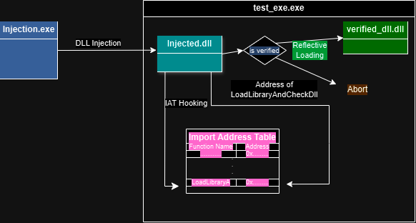
Design

Slide 6
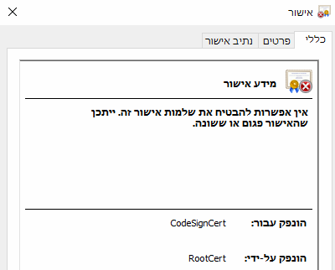
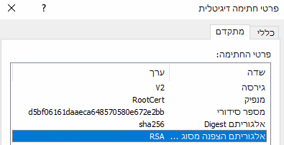
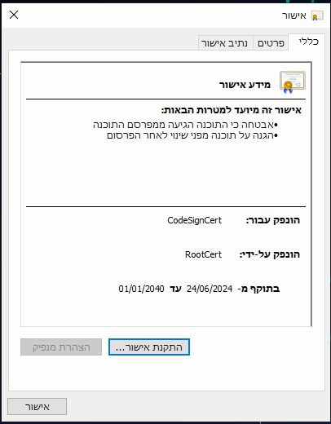
Signing
PVK – Private Key File
RootCert & CodeSignCert
PFX - Personal Information Exchange File
signtool sign
Import

Slide 7
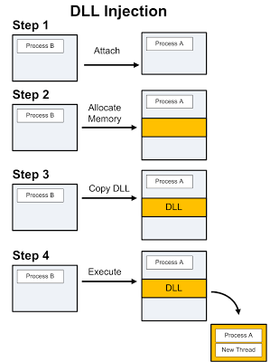
DLL Injection
Attach – OpenProcess
Allocate memory for DLL’s Path
Load the DLL using remote thread

Slide 8
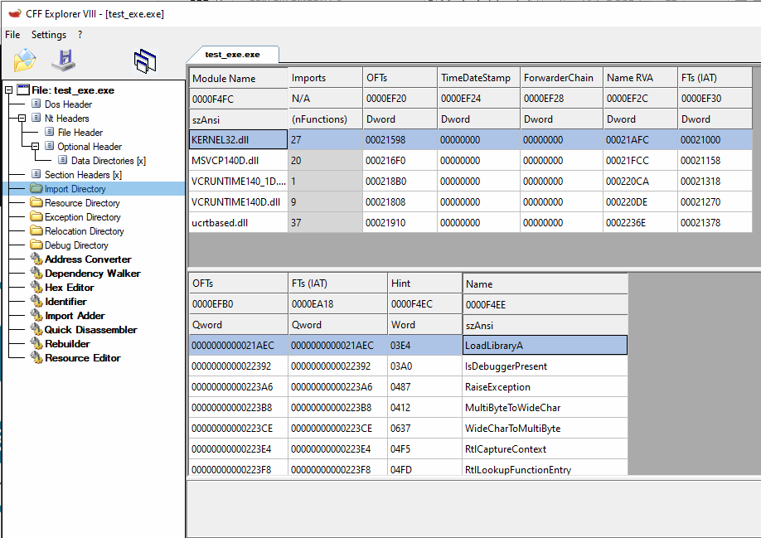
IAT Hooking – Import Address Table

Slide 9
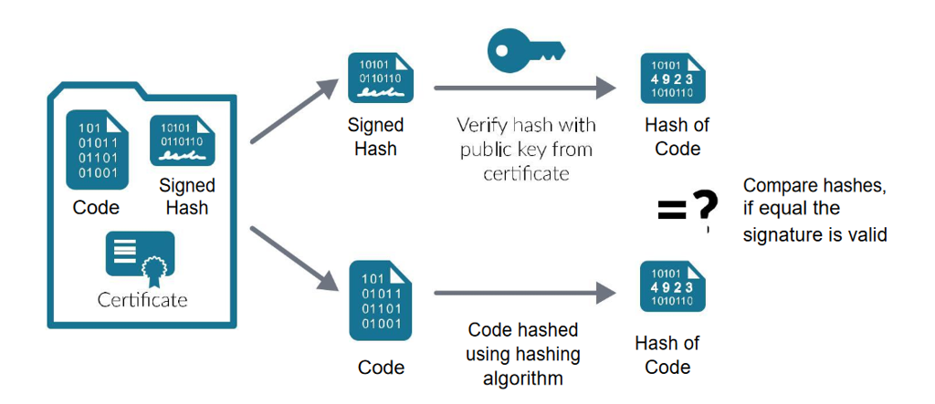
Verification

Slide 10
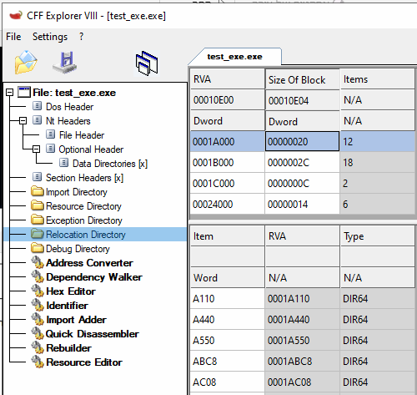
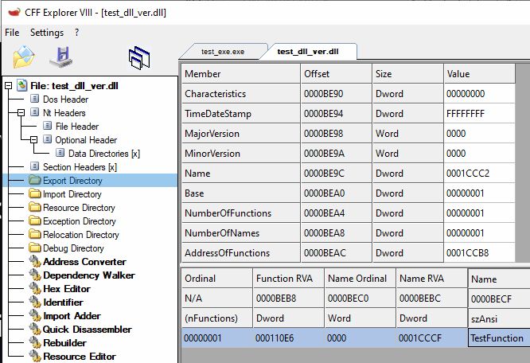
Reflective Loading
Allocation
Section copying
Relocation
Import Resolution
Export Processing
DllMain Execution

Slide 11
Demonstration
test_exe.exe
test_dll.dll - unverified
test_dll_verified.dll - verified version of test_dll.dll
Injection.exe

Slide 12


Slide 13
Future Improvements
DLL Main of loaded verified DLL
Running the injection manually

Slide 14
תודה על ההקשבה! שאלות?
יאיר לסרי – yairlasri3@gmail.com
רועי גרוס – roeygross16@gmail.com

